Slide 2
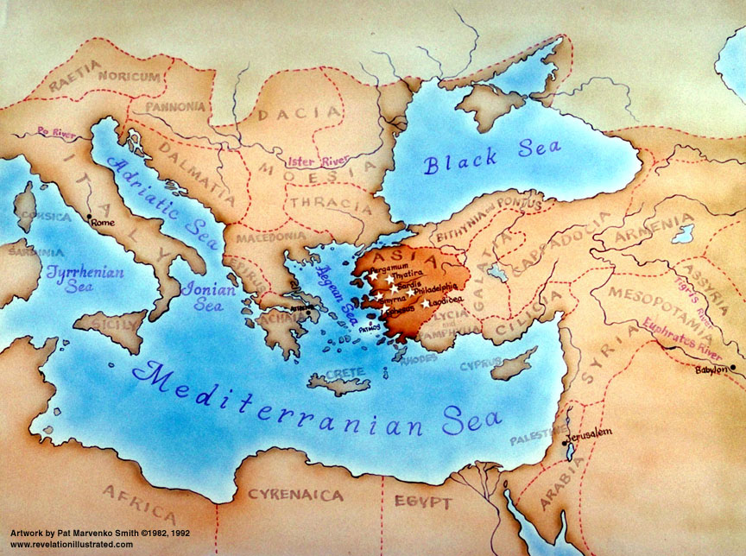
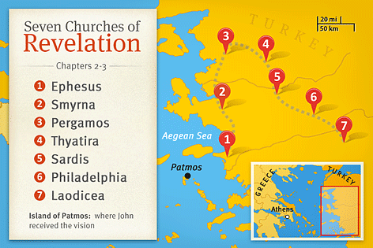
Laodicea
A wealthy city
Famous high quality garments
Large health industry
Local hot water spa

Slide 3
Revelation 3:14-22

Slide 4
¹⁴ “And to the angel of the church in Laodicea write: ‘The words of the Amen, the faithful and true witness, the beginning of God’s creation.
¹⁵ “ ‘I know your works: you are neither cold nor hot. Would that you were either cold or hot! ¹⁶ So, because you are lukewarm, and neither hot nor cold, I will spit you out of my mouth. ¹⁷ For you say, I am rich, I have prospered, and I need nothing, not realizing that you are wretched, pitiable, poor, blind, and naked. ¹⁸ I counsel you to buy from me gold refined by fire, so that you may be rich, and white garments so that you may clothe yourself and the shame of your nakedness may not be seen, and salve to anoint your eyes, so that you may see. ¹⁹ Those whom I love, I reprove and discipline, so be zealous and repent.

Slide 5
²⁰ Behold, I stand at the door and knock. If anyone hears my voice and opens the door, I will come in to him and eat with him, and he with me. ²¹ The one who conquers, I will grant him to sit with me on my throne, as I also conquered and sat down with my Father on his throne. ²² He who has an ear, let him hear what the Spirit says to the churches.’ ”

Slide 6
To the church at Laodicea... Jesus had nothing good to say about this church
Jesus is a reliable, faithful and true witness. He tells it like it is.
The church in Laodicea is lukewarm (neither cold or hot).
A lukewarm church makes Jesus sick
Indifference
A lukewarm church fails to be a witness for Jesus
Jesus would rather they got right out (cold) than be half-hearted disciples
Independence
A church who were self-confident
Patronage
Vs
Privilege
“I support that church.....”
“That church supports me.....”
They thought they were rich and had everything they needed
But spiritually they were wretched, pitiable, poor, blind and naked
Jesus rebukes and disciplines His church... “Be zealous and repent”

Slide 7
Jesus knocks at the door of a church.
Indifference & Independence
Jesus rebukes and disciplines His church...
“Be zealous and repent”
Why is the door not answered?
too absorbed
too afraid
too ashamed
too independent
If we open the door:
there is relationship
there is Reward.

